Slide 1
knowledge and language

Slide 2
theories of firms/ business models
Morgan: machine bureaucracy, psychic prison, brain, culture, etc.
emergent
transaction cost minimization
economic rents
knowledge-based theory
Notes:
expressly economic

Slide 3
rents

Slide 4
total subordination
partial subordination (principal-agent)
managers
create rents ?
boundary between ‘universes of control’
heterogeneous ‘purposes’
employees

Slide 6
legally and politically legitimated - the ‘corporation’
‘the firm’ - a ‘socio-economic apparatus’ made up of
people who know what they are doing
resources they need to move towards the entrepreneur’s goals
imagination to overcome ‘unforeseen problems’

Slide 7
if everything that happens in a business situation is “well-known”
there is no opportunity for profit
gets competed away
rents arise from knowing goal-relevant stuff that others do not
knowing ? = overcoming ‘knowledge-absences’ impeding progress to our goals

Slide 8
creating knowledge
experience ‘not-knowing’ - problem
sense an ‘opportunity space’
control the space
project imagination into that space
‘own’ the filled space
1. NOT learning about ‘reality’
2. task problem solving
3. in the mind vs in the world

Slide 9
uncertainty in the socio-economy
ignorance
of what is knowable
indeterminacy
game theory
incommensurability
fragmented knowledge

Slide 10
creating knowledge - innovation
applying prior science
creating new knowledge
art - practice
shape through language

Slide 11
firm as ‘body of knowledge’
objective (explicit)
‘tacit’
creating knowledge
knowledge economy
knowledge management
Internet
firm (local)
social/market

Slide 12
language
formal
natural

Slide 13
what does a firm’s ‘business language’ do ?
channels peoples’ attention
indicates the meaning of events, problems, resources, solutions, time
Notes:
what happened, diagnosis, Penrose, finished ? urgency windows of opportunity

Slide 14
constructing language to grasp:
events
problems - diagnosis
resources
solutions - pisteis
time

Slide 15
rhetoric (persuasive talk)
logos
ethos
pathos

Slide 17
managers’ knowledge practices
generate specific language (jargon)
communicate to instruct & persuade
listen

Slide 18
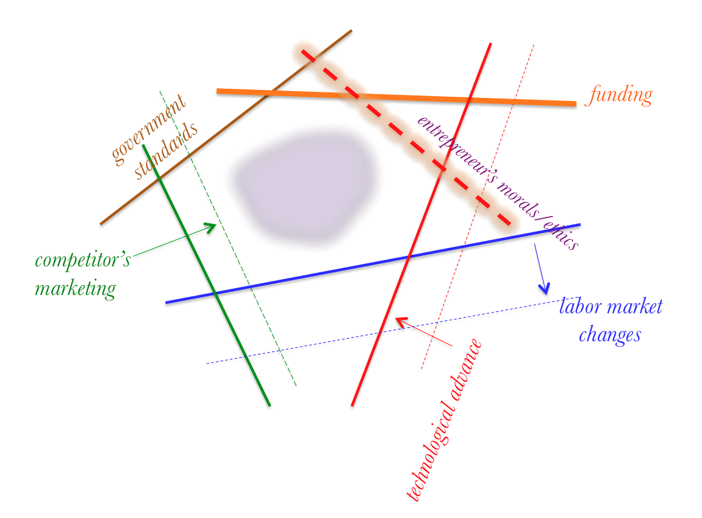
managers’ space of control
opportunity

Slide 19
managing is a talking game
the firm’s language enables power
rules
prioritization
passion
history
stories

Slide 20
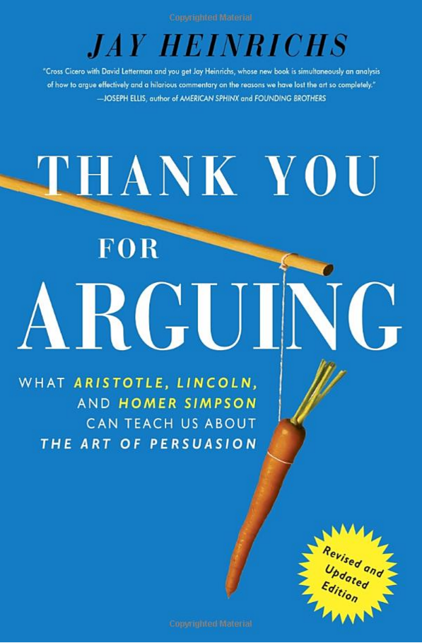
rhetoric
logos, ethos, pathos
canons
inventio (develop an argument)
dispositio (arrangement)
elecutio (style of presentation)
memoria
actio (delivery)
firm as a unique universe of language

Slide 21
social contract
private firms – leveraging private property
‘engine’ of democratic capitalism
at society’s pleasure - business ethics & CSR
where new economic value comes from

Slide 22
managing the tensions between firms and society
history of labor / capital relations
Piketty
Precariat
benefits and costs of institutionalizing and legitimating firms as the ‘the engines of capitalism’

