Slide 1
culture, ethics, values
what do managers want from employees, contractors, suppliers, customers, etc ?
physical labor - calculation - judgment
scientific management
most OT theory
managerial practice

Slide 3
Values - ‘Christian Virtues’
courage
justice
temperance
wisdom
faith
hope
charity
https://www.thoughtco.com/the-cardinal-virtues-542142
https://www.thoughtco.com/what-are-the-theological-virtues-542106

Slide 5
business ethics
‘consequentialist’, ‘deontological’, and ‘virtue’
Consequentialism is non-prescriptive, meaning the moral worth of an action is determined by its consequences, not by whether it follows edicts or laws - e.g. lying under oath to save an innocent person's life. Selecting crashes.
Deontological ethics wherein rules and moral duty are central, seeing the rightness or wrongness of practice arising from the character of the behavior not its outcome.
Virtue ethics, which focuses on the character of the actor rather than on the consequences or the nature of the act (or its omission) itself.

Slide 7
ethics meet work-place reality

Slide 8
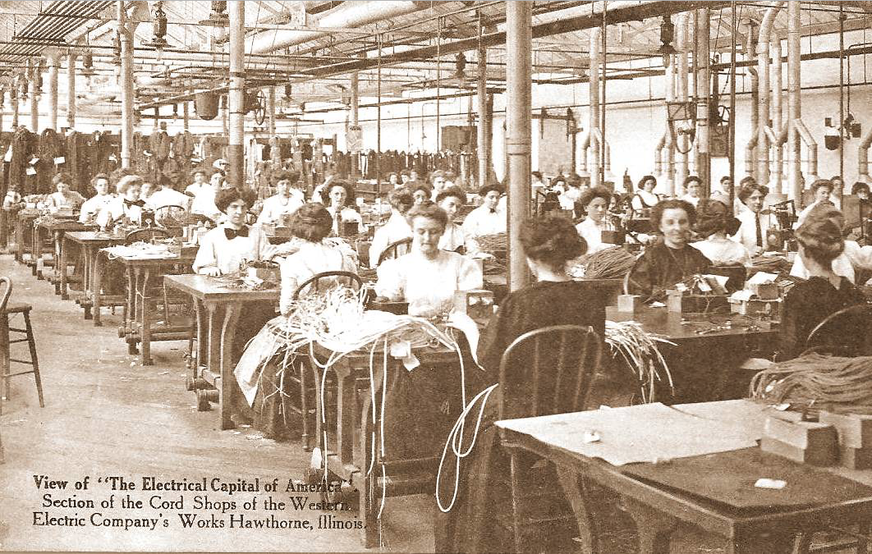

Slide 12
Hawthorne studies showed
work-place is a values-infused social system, not a value-free machine
employees influenced by power - social, monetary, and otherwise
participation in work-role is always a problem
there are ‘group’ effects

Slide 13
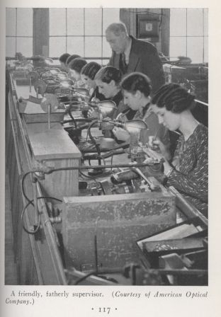

Slide 14
Milgram Studies

Slide 15
mythology of:

Slide 16
best way to organize ?
it all depends - labor - calculation - judgment
exercise power
incentives to accept authority
incentives to collaborate
direct instruction
persuasion (rhetoric/talk)
manage workplace culture - values - ethics

Slide 17
Morgan’s
Images of Organization

Slide 18
extending Morgan’s typology
transaction costs
machine
community
market
firms arise when they provide coordination more economically than can the available markets
but what about non-market self-organization?

